Slide 1
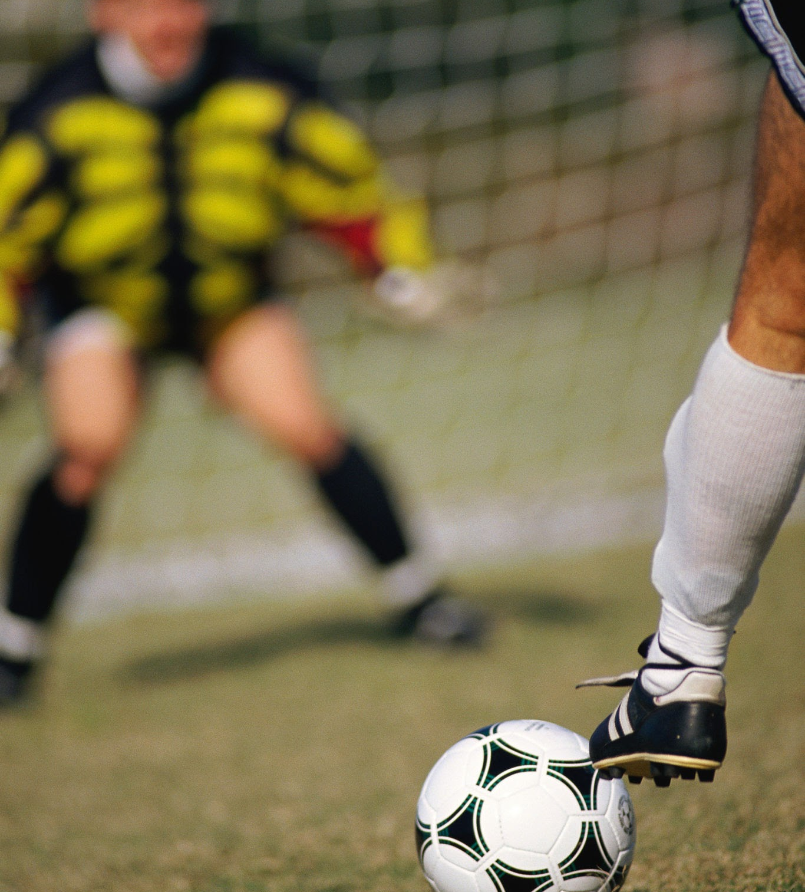
Does Ball Possession Predict Winning in Professional Soccer?
DATA 606 Final Project
Fall 2025
CUNY School of Professional Studies
Presented By:
João De Oliveira
Notes:
Hi everyone, my name is João De Oliveira, and today I will present my final analysis for DATA 606, where I examine whether ball possession truly predicts winning in professional soccer.

Slide 2
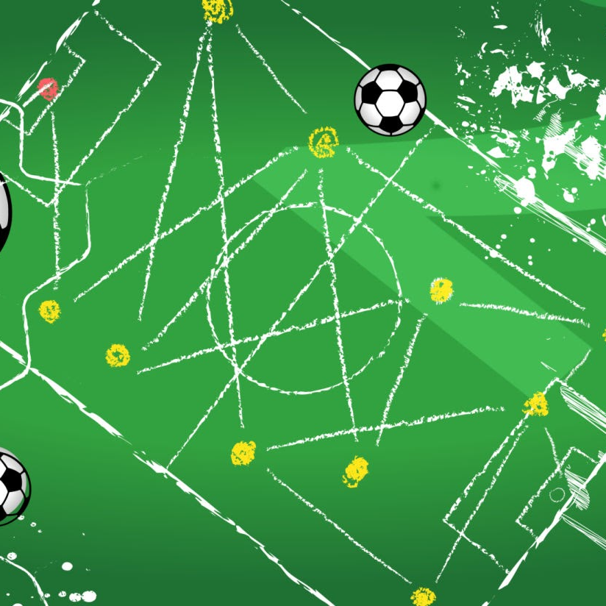
Abstract
Analyzed ~96,000 professional soccer matches across 18 leagues.
Conducted chi-square tests and logistic regression models.
Possession shows a significant association with winning but weak predictive power.
When shots on goal and home advantage are included, possession’s effect weakens or reverses.
Conclusion: Possession reflects style, not success.
Link for full abstract: https://docs.google.com/document/d/10_eI2MyxtP7cZClXOaWdb2XwSi1feiyaoB8pvl5Vovc/edit?usp=sharing
Notes:
This is a summary of the entire project. Even though possession correlates with winning, it’s not a strong predictor. More importantly, its effect almost disappears when we account for shots and home advantage.

Slide 3
Overview and Context
Soccer dynamics characteristics
Possession is commonly viewed as a measure of dominance.
Counter attacking teams often win despite low possession.
This study explores how strongly possession itself relates to match outcomes.
Notes:
There’s a general belief that possession means dominance. But many teams—like Atlético Madrid or some Premier League mid-table clubs—win with less possession. This motivated the study.

Slide 4
Data & Source
Kaggle Football DataSet
Complete Football Data — 96,000+ matches, 18 leagues
Unit of analysis: team-match (two observations per match).
Variables include: goals, possession %, shots on goal, fouls, cards, etc.
Notes:
This is a very large dataset—nearly one hundred thousand rows. Each match becomes two rows because we analyze each team independently.

Slide 5

Dependent Variable
Soccer Game Outcome
team_win_bin = 1 → team won the match
team_win_bin = 0 → draw or loss
Type: Binary categorical
Notes:
I simplified the outcome to a binary win vs not-win variable. This is standard for logistic regression.

Slide 6
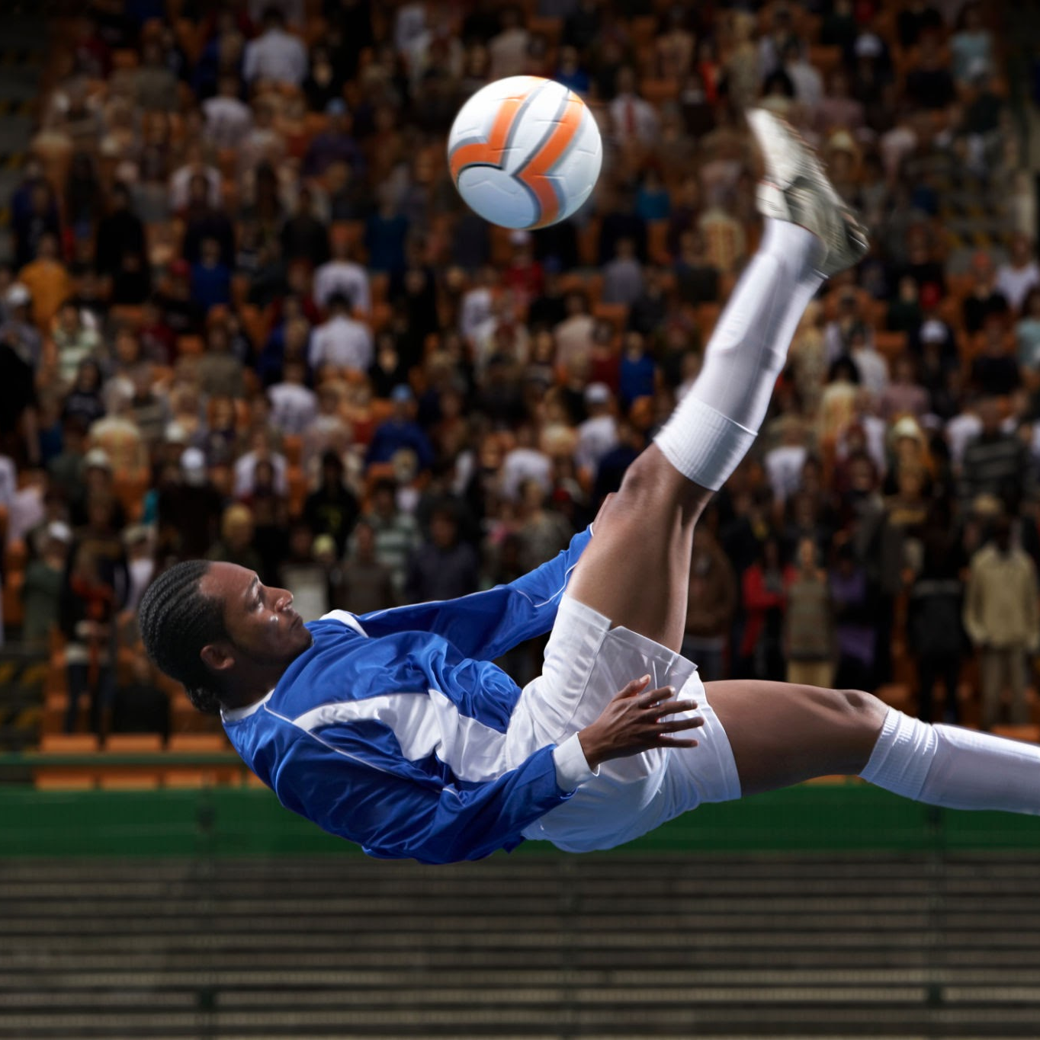
Independent Variable
Main Variable is Ball Possession: team_poss (possession %)
is_home (1 = home) - Model 2
team_sog (team shots on goal) - Model 2
opp_sog (opponent shots)
Notes:
Possession is the main variable, but shots on goal and home advantage are crucial control variables.

Slide 7
Research Question
Observational Study
Observational Study Model 2
Does higher possession increase the probability of winning?
Does this remain true when controlling for shots and home-field advantage?
Notes:
Two questions: first, the simple relationship. Second, the realistic one—after controlling for more meaningful performance metrics.

Slide 8
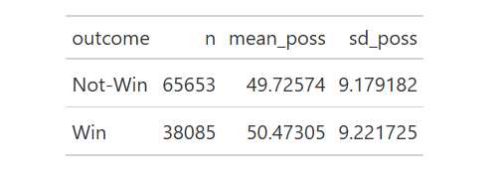
Summary Statistics
103738 team-matches after cleaning
Mean possession:
Win = 50.47%
Not-Win = 49.73%
Small but noticeable difference
Min. 1st Qu. Median Mean 3rd Qu. Max.
## 10 44 50 50 56 90
Notes:
There is a small difference in average possession between winners and non-winners. But this difference alone is not enough to draw conclusions.

Slide 9
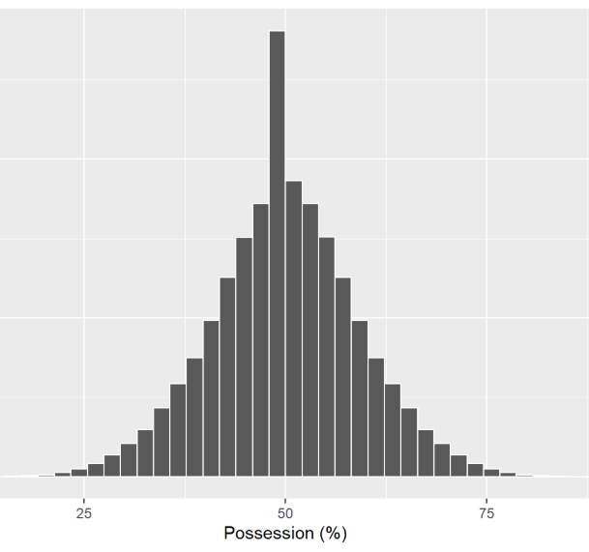
Distribution of Possession
Centered around 50%
Roughly symmetric
Extreme values are rare
Notes:
The distribution shows that most teams hover around 50% possession.

Slide 10
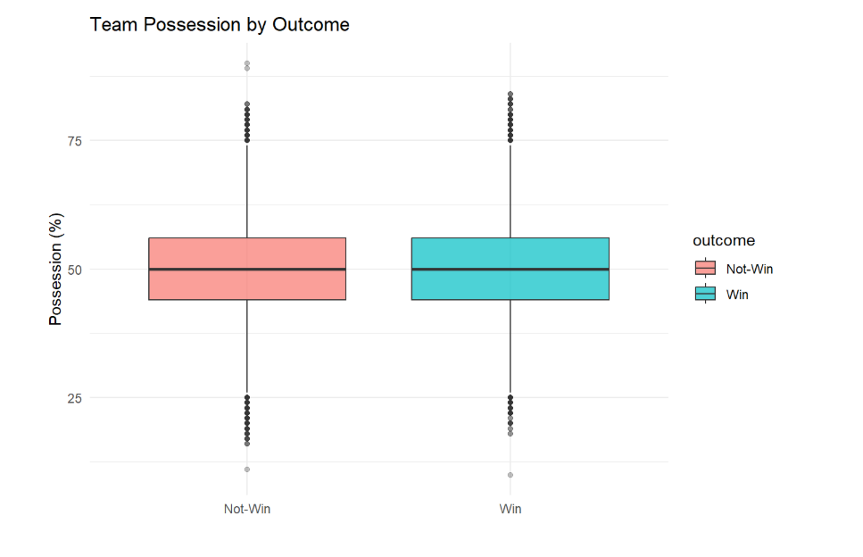
Possession by Outcome
Winners show slightly higher median possession
Heavy overlap → weak separation
Notes:
This boxplot shows that possession alone doesn’t differentiate winners and losers very well.

Slide 11
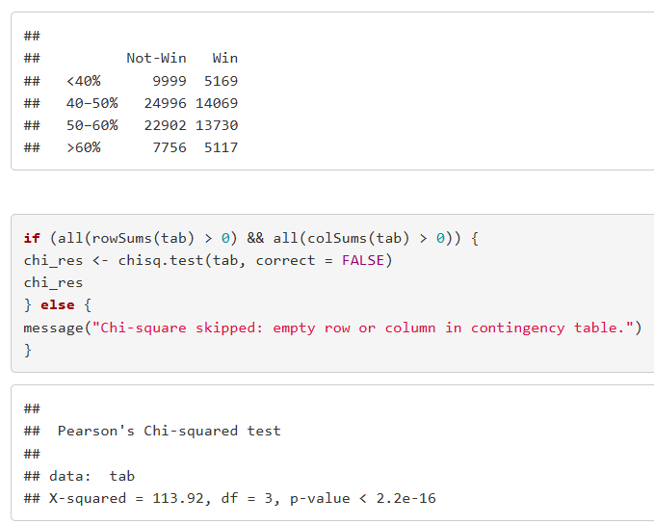
Chi-Square Test
Null hypothesis (H₀): Possession is not associated with Win vs Not-Win (no difference in distribution across outcomes)
Alternative hypothesis (Hₐ): Possession is associated with Win vs Not-Win.
X² = 113.92, df = 3, p < 2.2e-16
Reject H₀
Notes:
The chi-square test confirms an association, but not strength of prediction.

Slide 12
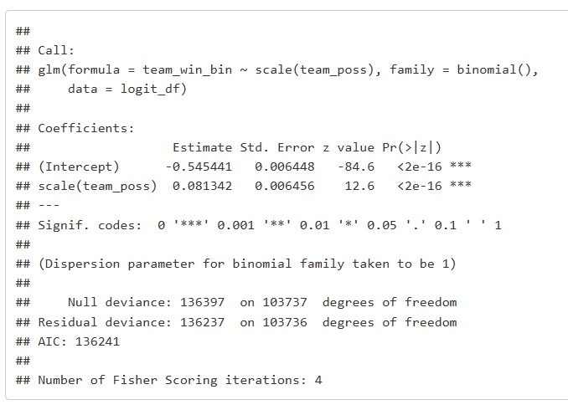
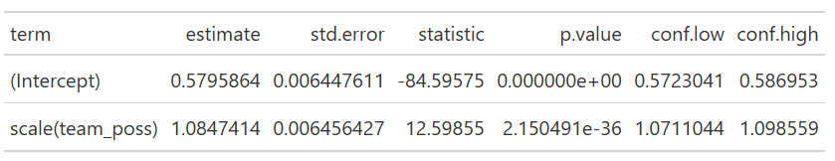
Logistic Regression Model 1
Model 1: Possession Only
β = 0.0813, p < 2e-16
Odds Ratio ≈ 1.08
AUC ≈ 0.52 (almost like guessing)
Conclusion: Weak predictor
Notes:
Possession is statistically significant, but practically weak. AUC of 0.52 is barely above random. For every 1 standard deviation increase in possession, the odds of winning increase by about 8%. That is a very small effect.

Slide 13
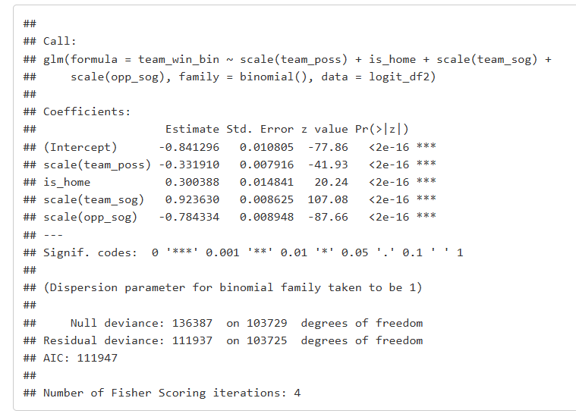
Logistic Regression Model 2
Model 2: Possession + Controls
β_poss = −0.33, p < 2e-16
Shots on goal: strongest predictor
Home advantage: significant
AIC improves from 136241 → 111947
Notes:
After controlling for shots on target and home advantage, possession loses importance and reverses direction. The AIC for Model 2 is dramatically lower than Model 1, meaning the model becomes far better at explaining match outcomes when we add shots on goal and home advantage. Possession alone is not enough – but including shot creation and defensive pressure makes the model substantially stronger.

Slide 14
Why This Matters?
Possession ≠ dominance
Shots and defensive suppression matter more
Helps teams rethink tactical focus
Chance quality (xG-style metrics) is more meaningful than possession volume
The research spanned a 20 year period, from 2002 to 2022.
Notes:
This analysis supports modern analytics: quality of chance if far more important than ball possession.

Slide 15
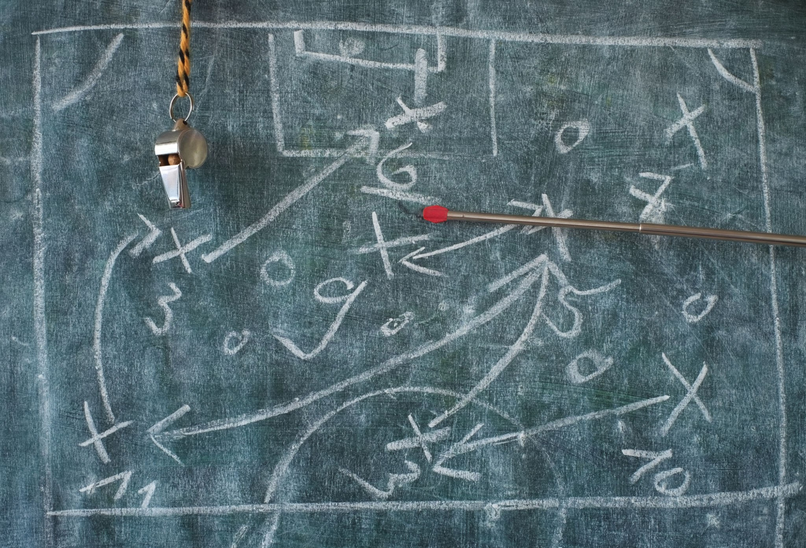
Limitations
Observational data → cannot infer causality
Missing variables: xG, team strength, tactics
Possession changes with game state (score)
Outcome simplified
Notes:
After controlling for shots on target and home advantage, possession loses importance and reverses direction. The AIC for Model 2 is dramatically lower than Model 1, meaning the model becomes far better at explaining match outcomes when we add shots on goal and home advantage. Possession alone is not enough – but including shot creation and defensive pressure makes the model substantially stronger.

Slide 16
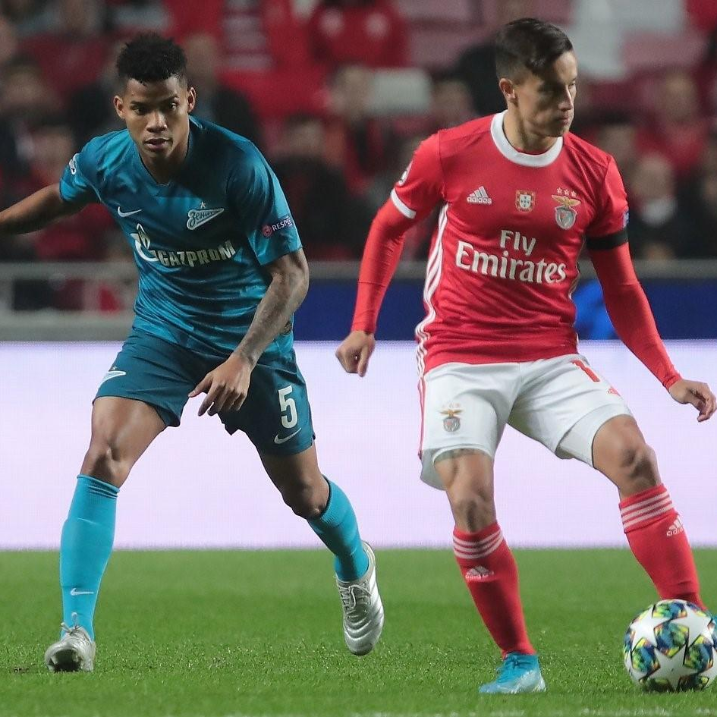
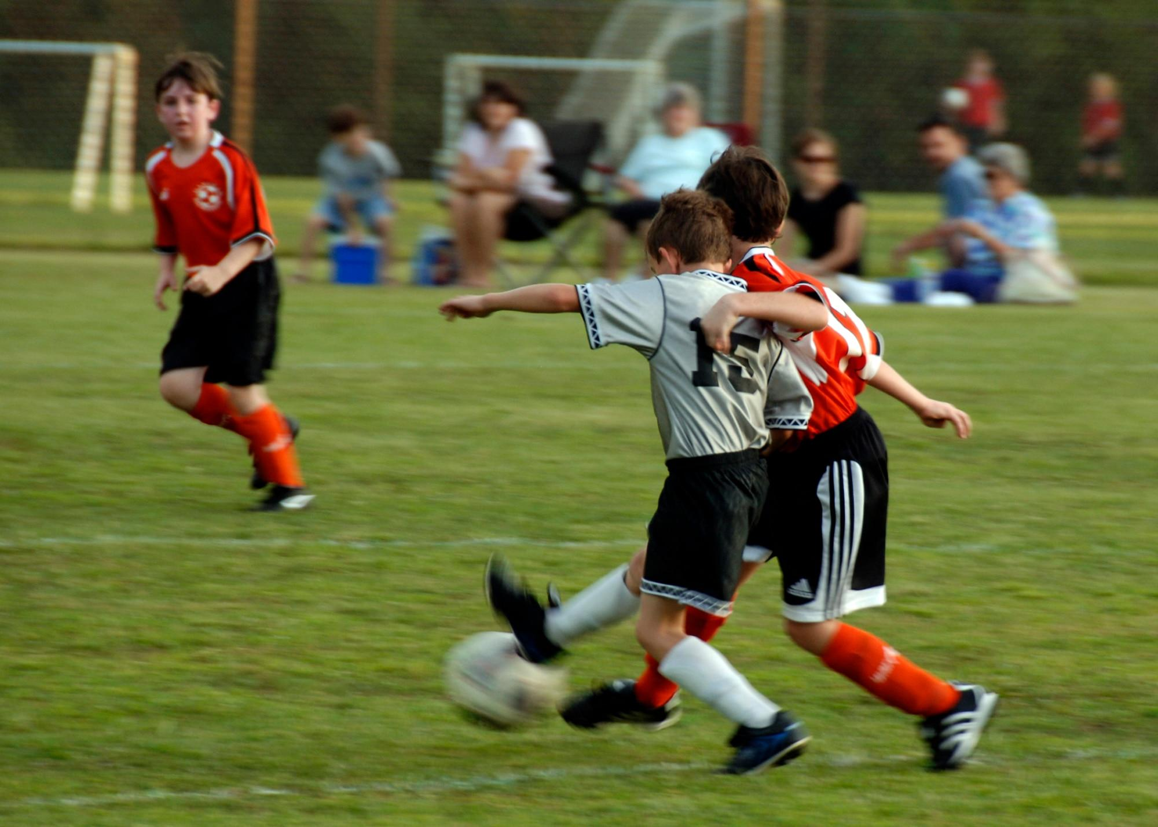

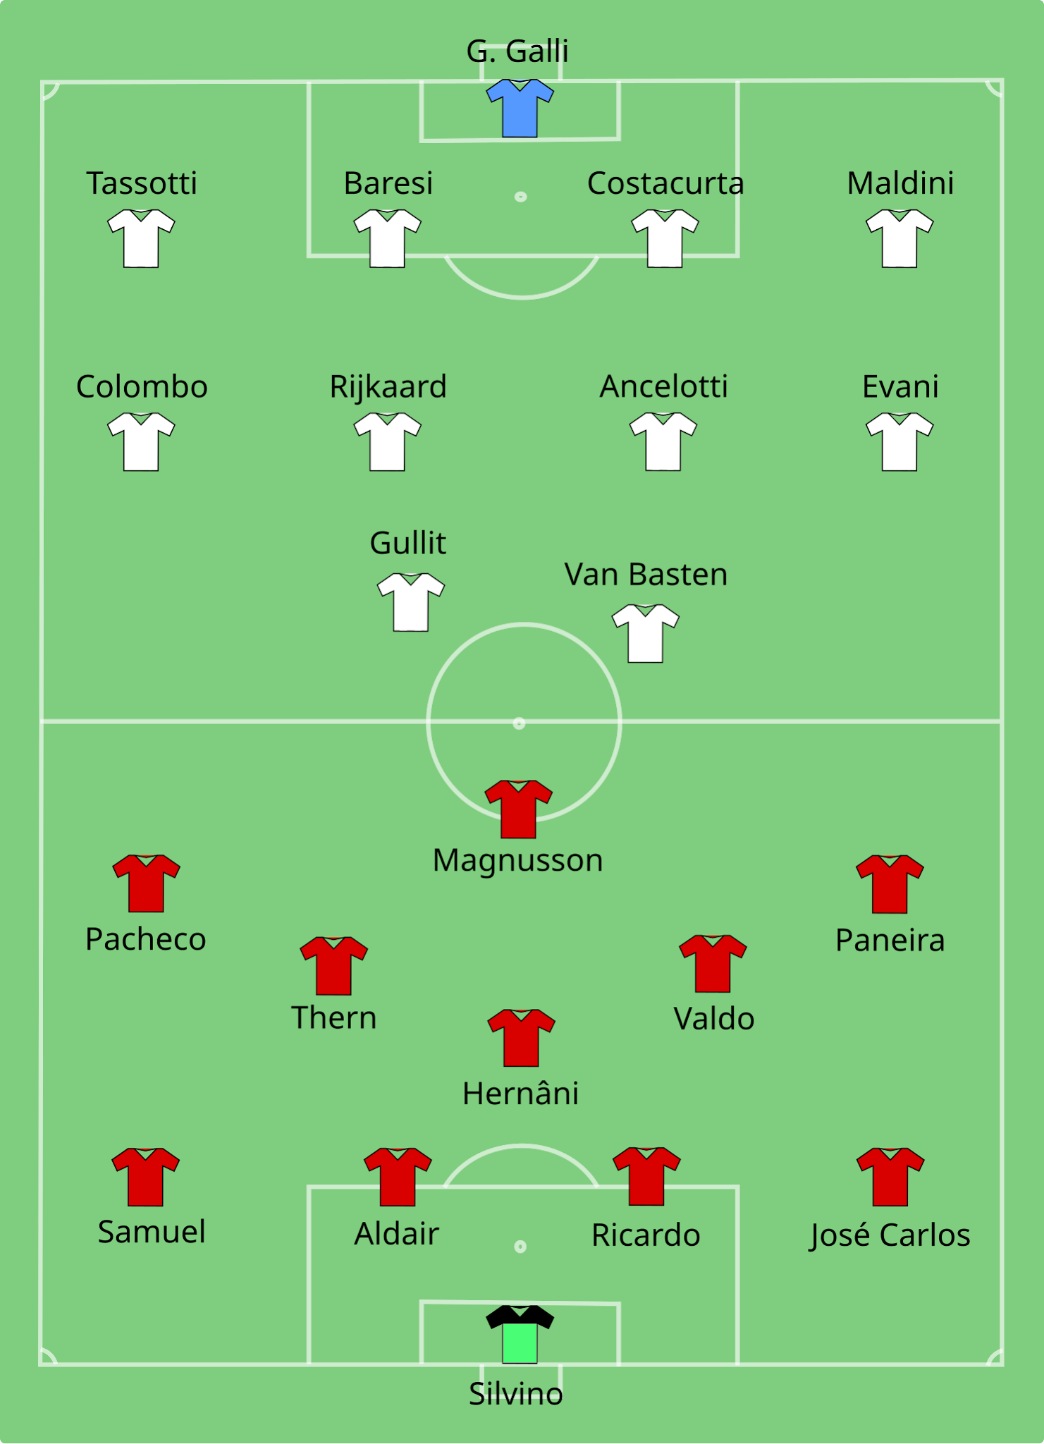

Conclusions and Takeaway
Possession has weak predictive value
Shots on goal and home advantage matter more
Possession reflects style, not success
Future work: xG, team fixed effects, league-level analysis
Notes:
In the end, possession is not a reliable predictor of winning. Rather than indicating match success, it primarily reflects a team’s tactical style and game-state dynamics.

